Slide 1
Norton Nabs a Nu!
AN introduction to the physics of neutrinos
Paul Nienaber
(with apologies to Dr Seuss…)

Slide 2
canto 1: golly, golly, Dr. Pauli!
Some scientists working on nuclear breakup
Saw something that gave all their theories a shake-up.
“These beta-producers defy explanation!
They’re showing us energy non-conservation!”
Some nuclei (the unimaginably dense kernels at the core of all atoms) are unstable, and spontaneously split apart. Most of these decays produce one of three kinds of ejecta:
- alpha (α) particles (identified as nuclei of helium)
- beta (β) particles (identified as electrons/positrons)
- gamma (γ) particles (identified as photons)
ca. 1927

Slide 3
canto 1: golly, golly, Dr. Pauli!
Some scientists working on nuclear breakup
Saw something that gave all their theories a shake-up.
“These beta-producers defy explanation!
They’re showing us energy non-conservation!”
When a nucleus α-decays,
the emitted α always comes out with the same energy
– just as you’d expect:
because it’s a TWO BODY decay
x
x'
α
ca. 1927

Slide 4
canto 1: golly, golly, Dr. Pauli!
Some scientists working on nuclear breakup
Saw something that gave all their theories a shake-up.
“These beta-producers defy explanation!
They’re showing us energy non-conservation!”
If you observed a large number of these decays,
and measured the α’s energy in each case,
you’d get a graph that looked something like this:
number of α’s
α emitted with energy E
E
energy

Slide 5
canto 1: golly, golly, Dr. Pauli!
Some scientists working on nuclear breakup
Saw something that gave all their theories a shake-up.
“These beta-producers defy explanation!
They’re showing us energy non-conservation!”
Let’s do the same thing with nuclei that emit BETA particles…
since we only see one β coming out, we expect the same thing:
all β’s with the same energy…
but that’s NOT
what we get!
Y'
number of β’s
Y
β
β emitted with energy E
E
energy

Slide 6
canto 1: golly, golly, Dr. Pauli!
Some scientists working on nuclear breakup
Saw something that gave all their theories a shake-up.
“These beta-producers defy explanation!
They’re showing us energy non-conservation!”
This graph, or spectrum, is at the heart of the β-decay puzzle:
and sometimes not, by a lot!
sometimes energy appears to be conserved…
Y'
number of β’s
Y
β
ca. 1927
energy

Slide 7
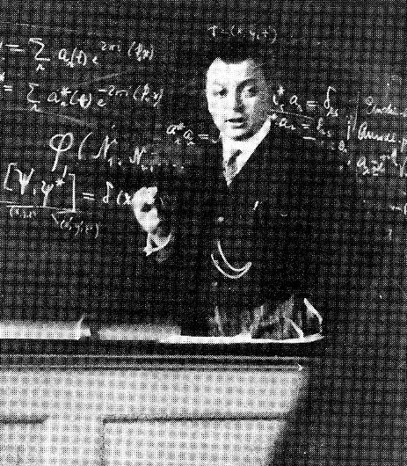
canto 1: golly, golly, Dr. Pauli!
Another researcher, a theorist named Pauli
Remarked, “I have solved it! Eureka, by golly!
You think these decays to be just bifurcation –
But TRIOS are really the split situation!”
Some scientists working on nuclear breakup
Saw something that gave all their theories a shake-up.
“These beta-producers defy explanation!
They’re showing us energy non-conservation!”
Y
Y'
β
Y'
Y
β
Wolfgang Pauli
ca. 1927

Slide 8
canto 1: golly, golly, Dr. Pauli!
“A new sort of beastie – aloof and elusive,
Both chargeless and massless, it’s downright reclusive!
It zips through detectors; your catchers all miss it!
It carries the leftover energy with it!”
Another researcher, a theorist named Pauli
Remarked, “I have solved it! Eureka, by golly!
You think these decays to be just bifurcation –
But TRIOS are really the split situation!”
zero electric charge
zero mass
interacts very feebly,
if at all
Y
Y'
β
“The nucleus doesn’t just spit out a beta,
A ‘ghost’ comes out, too – this will fix up your data!
‘But where’s the third piece?’
I can hear you protesting,
‘We’ve looked, we saw nothing!’
Here’s what I’m suggesting…”
Wolfgang Pauli

Slide 9
canto 1: golly, golly, Dr. Pauli!
“A new sort of beastie – aloof and elusive,
Both chargeless and massless, it’s downright reclusive!
It zips through detectors; your catchers all miss it!
It carries the leftover energy with it!”
zero electric charge
zero mass
interacts very feebly,
if at all
Y
Y'
β
ν
So people agreed to accept this new thingy,
Though extra ghost particles seemed a bit ding-y.
Quipped Fermi, “How should we denote this bambino?
It’s little! It’s neutral! Let’s call it neutrino!”
ca. 1927

Slide 10
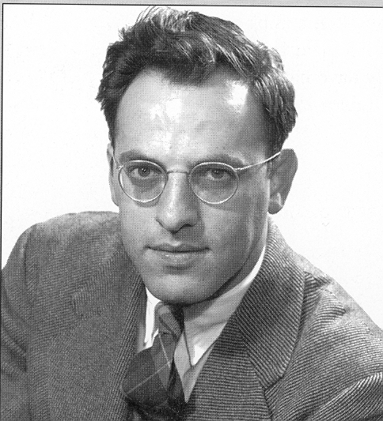

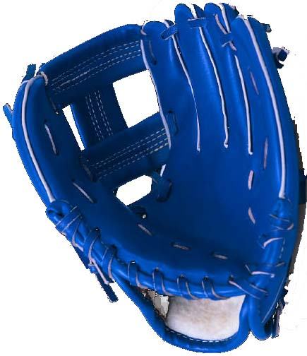
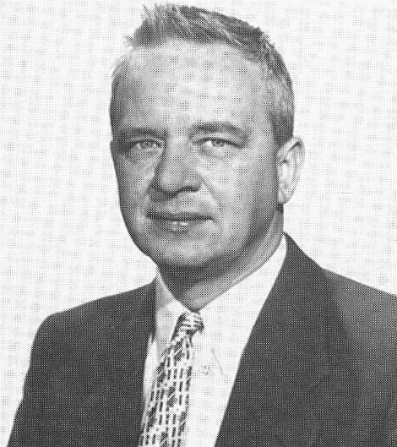
canto 2: Norton nabs a nu!
For thirty-odd years, that was status neutrino:
No hits and no runs – they remained quite unseen-o.
Fred Reines and colleague Clyde Cowan decided
To search for these particles, as yet unsighted.
Two things were required to catch sight of these specters:
A copious source and a large-scale detector.
ca. 1955

Slide 11
canto 2: Norton nabs a nu!
So Cowan and Reines concocted a plan which
Used stacked photon-catchers
– a strange sort of sandwich.
To glimpse a clear footprint that all would believe
They needed a hallmark that only ν’s leave.
neutrino target
photon catcher
Notes:
scintillator boxes: 6’ x 4.5’ x 2’; water boxes: 6’ x 4.5’ x 3”

Slide 12
canto 2: Norton nabs a nu!
By chance, a neutrino encount’ring a proton,
Will alter, by putting a positive coat on,
Becoming an anti-electron, then turning
The proton to neutron.
Quite simple? You’re learning…
ν
e⁺
p
n
neutrino target
photon catcher

Slide 13
canto 2: Norton nabs a nu!
So how can you tell if a hit really happened?
The signal’s distinctive – here’s how you can tap in:
The anti-electron’s a time-bomb unfailing --
E-plus plus e-minus makes photons go sailing.
ν
e⁺
e⁻
p
n
neutrino target
photon catcher

Slide 14
canto 2: Norton nabs a nu!
The neutron will wander, then find a new home,
And out some additional photons will come.
These light-bursts together – a marker so clear:
It’s as if the neutrino had yelled out, “I’m here!”
“I’m here!”
ν
e⁺
p
n
neutrino target
photon catcher

Slide 15
canto 2: Norton nabs a nu!
They built their detector beneath the reactor
And looked for a year, and cross-checked all the factors.
At last they announced it: no smoke and no mirr-ahs:
Neutrinos no longer were Pauli’s chimeras.
The source of neutrinos: a new and quite nifty
Reactor (recall this took place in the Fifties!).
For nuclear plants would appear to shine bright
If your eyes saw neutrinos instead of just light.
-----------------------------
W E S T E R N U N I O N
-----------------------------
June 14, 1956
Dear Professor Pauli,
We are happy to inform you
that we have definitely
detected neutrinos. . .
Fred Reines
Clyde Cowan
Savannah River
nuclear reactor
Notes:
Savannah River plant built by DuPont in South Carolina

Slide 16
canto 2: Norton* nabs a nu!
*Footnotes:
1) the particles that reactors produce are really ANTIneutrinos – they collide to produce ANTIelectrons. Neutrinos would make electrons.
2) Poetic license: Neither Fred Reines nor Clyde Cowan are named “Norton,” nor are either of them exactly household names – though Cowan did give his first name to a type of experiment where particle beams crash into each other; they’re called:
“CLYDE - RS”

Slide 17
canto 3: one neutrino, two neutrino, e neutrino, μ neutrino? part I
μ
Consider the curious puzzler, the muon:
It undergoes beta decay, not to two-ons
But three: one electron, and two tiny zipster
Neutrinos, and here’s the anomaly, hipsters:
You start with a μ ; it decays to an e,
Which means you’ve two diff’rent neutrinos, you see:
Paired up with the e, you get one ANTI-ν
Another neutrino is left from the μ.
Oh, my! Here’s a ν with an anti! you say:
Why don’t they make photons and vanish away?
ν
ν
e
?
γ
ca. 1960

Slide 18
canto 3: one neutrino, two neutrino, e neutrino, μ neutrino? part I
But wait: we don’t get this! No muons we see
Have ever decayed into γ plus e !
We solve it,
by seeing what does and what doesn’t:
We say: these aren’t opposites
– just, sort of, cousins…
For Nature, constructing the particle zoo,
Built separate compartments for e and for μ.
The muon decays to an anti- ν_{e}
And standard ν_{μ}, and electron, you see.
Neutrinos, type μ, simply will not combine
With antineutrinos that come in e kind.
μ
ν_{e}
ν
ν
e
ν_{μ}
μ
γ
e
ca. 1960

Slide 19
canto 3: one neutrino, two neutrino, e neutrino, μ neutrino? part I
The kind of neutrinos we shoot at detectors
Determines the stuff that collects in collectors.
Electron neutrinos react to make e’s
And muon neutrinos make μ’s, Q.E.D.
ca. 1960

Slide 20
canto 4: one neutrino, two neutrino, e neutrino, μ neutrino? part II
Our theory of how the world worked said, “ν_{e}’s
Should stay as ν_{e}’s, and ν_{μ}’s, if you please,
Should stay as ν_{μ}’s”
-- which sounds simple and stable,
But nature puts something quite else on the table.
Neutrinos aren’t massless, as once we had thought.
“Just how do you know that?” (We get that a lot. )
To “weigh” a neutrino requires application
Of something quite strange
that’s been dubbed “oscillation.”
ca. now

Slide 21
canto 4: one neutrino, two neutrino, e neutrino, μ neutrino? part II
A stream of neutrinos – ν_{μ}’s, let us say
Starts out on a trip from point I to point J
If asked at point I, all neutrinos would chime:
“We’re muon neutrinos at this point in time;
But as from point I to point J we go zappin’,
A quirky and quantum effect might just happen.
By quantum mechanical rules, we behave:
A particle sometimes can act like a wave!”
I
J
ν_{μ}

Slide 22
canto 4: one neutrino, two neutrino, e neutrino, μ neutrino? part II
How far does the wave stretch?
The length, crest to crest,
Is set by the particle’s mass, when at rest.
And waves interfere as they travel through space,
They add and subtract if they get out of phase.
Neutrinos do, too, if you get what I mean –
They’re made of components,
they’re not quite pristine.

Slide 23
canto 4: one neutrino, two neutrino, e neutrino, μ neutrino? part II
Let’s say that the thing that we’ve named as ν_{μ}
Is made of two pieces: ν₁ and ν₂.
(I know what it sounds like – you don’t smell a rat!
This isn’t just cadged from “The Cat in the Hat!”)

Slide 24
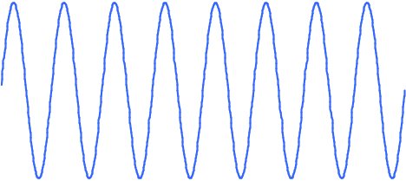
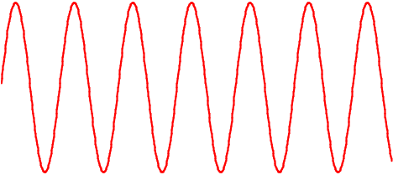
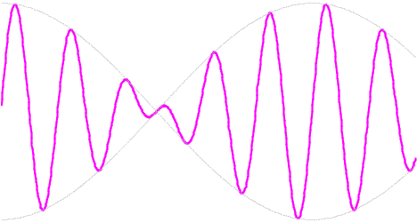
ν_{μ}
ν_{μ}
wave 1
wave 2
wave 1
+ wave 2

Slide 25
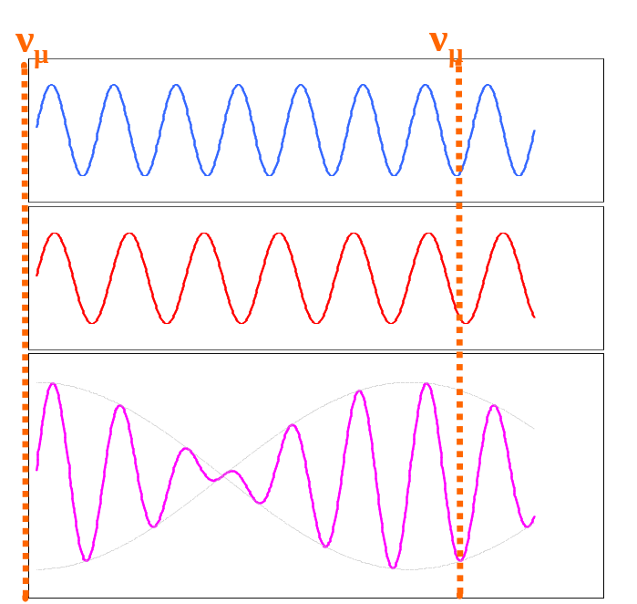
canto 4: one neutrino, two neutrino, e neutrino, μ neutrino? part II
They started their travels, ν₁ and ν₂,
Combined to comprise each initial ν_{μ}.
Remember, however,
these two pieces’ masses
Are not quite the same,
so as travel time passes
The waves, as they’re waving,
wave one and wave two,
Move out of the pattern that made a ν_{μ}!
But after a few ups and downings have darted
The waves will wave back to the way that they started.

Slide 26
canto 4: one neutrino, two neutrino, e neutrino, μ neutrino? part II
So what does this mean? This combined undulation
Explains the phenomenon called oscillation.
You start with ν_{μ}’s at initial point I,
Off zipping they go; if you stop to say, “Hi”
Downstream at point J,
where you placed your detector,
Some distance away from the ν_{μ} projector,
You’ll find, if you ask, “Hey, neutrinos! Are you
Neutrinos type e? Or neutrinos type μ?”
A tiny percentage have altered their stripe –
They were of type μ, but are now of e type!
The way that this sort of effect comes to pass
Can “weigh” a neutrino, determine its mass.

Slide 27
Coda
Neutrinos have come a long way since Herr Pauli
Set physicists off on this particle trolley.
Neutrinos illumine how nuclei work,
How suns start to shine, what odd myst’ries lurk
Inside neutron stars, and much other fun stuff –
It seems that they just cannot teach us enough!
Stay tuned! There are puzzles unsolved yet remaining,
More knots for untying, results for obtaining.
And thanks for perusing these verses abstruse:
Where Mr Neutrino has met Dr Seuss!

